Slide 1

Marriott & Artificial Intelligence
YWCC 307
Jibrael P, Brian B, Abraham M, Simon K
25 March 2023

Slide 2

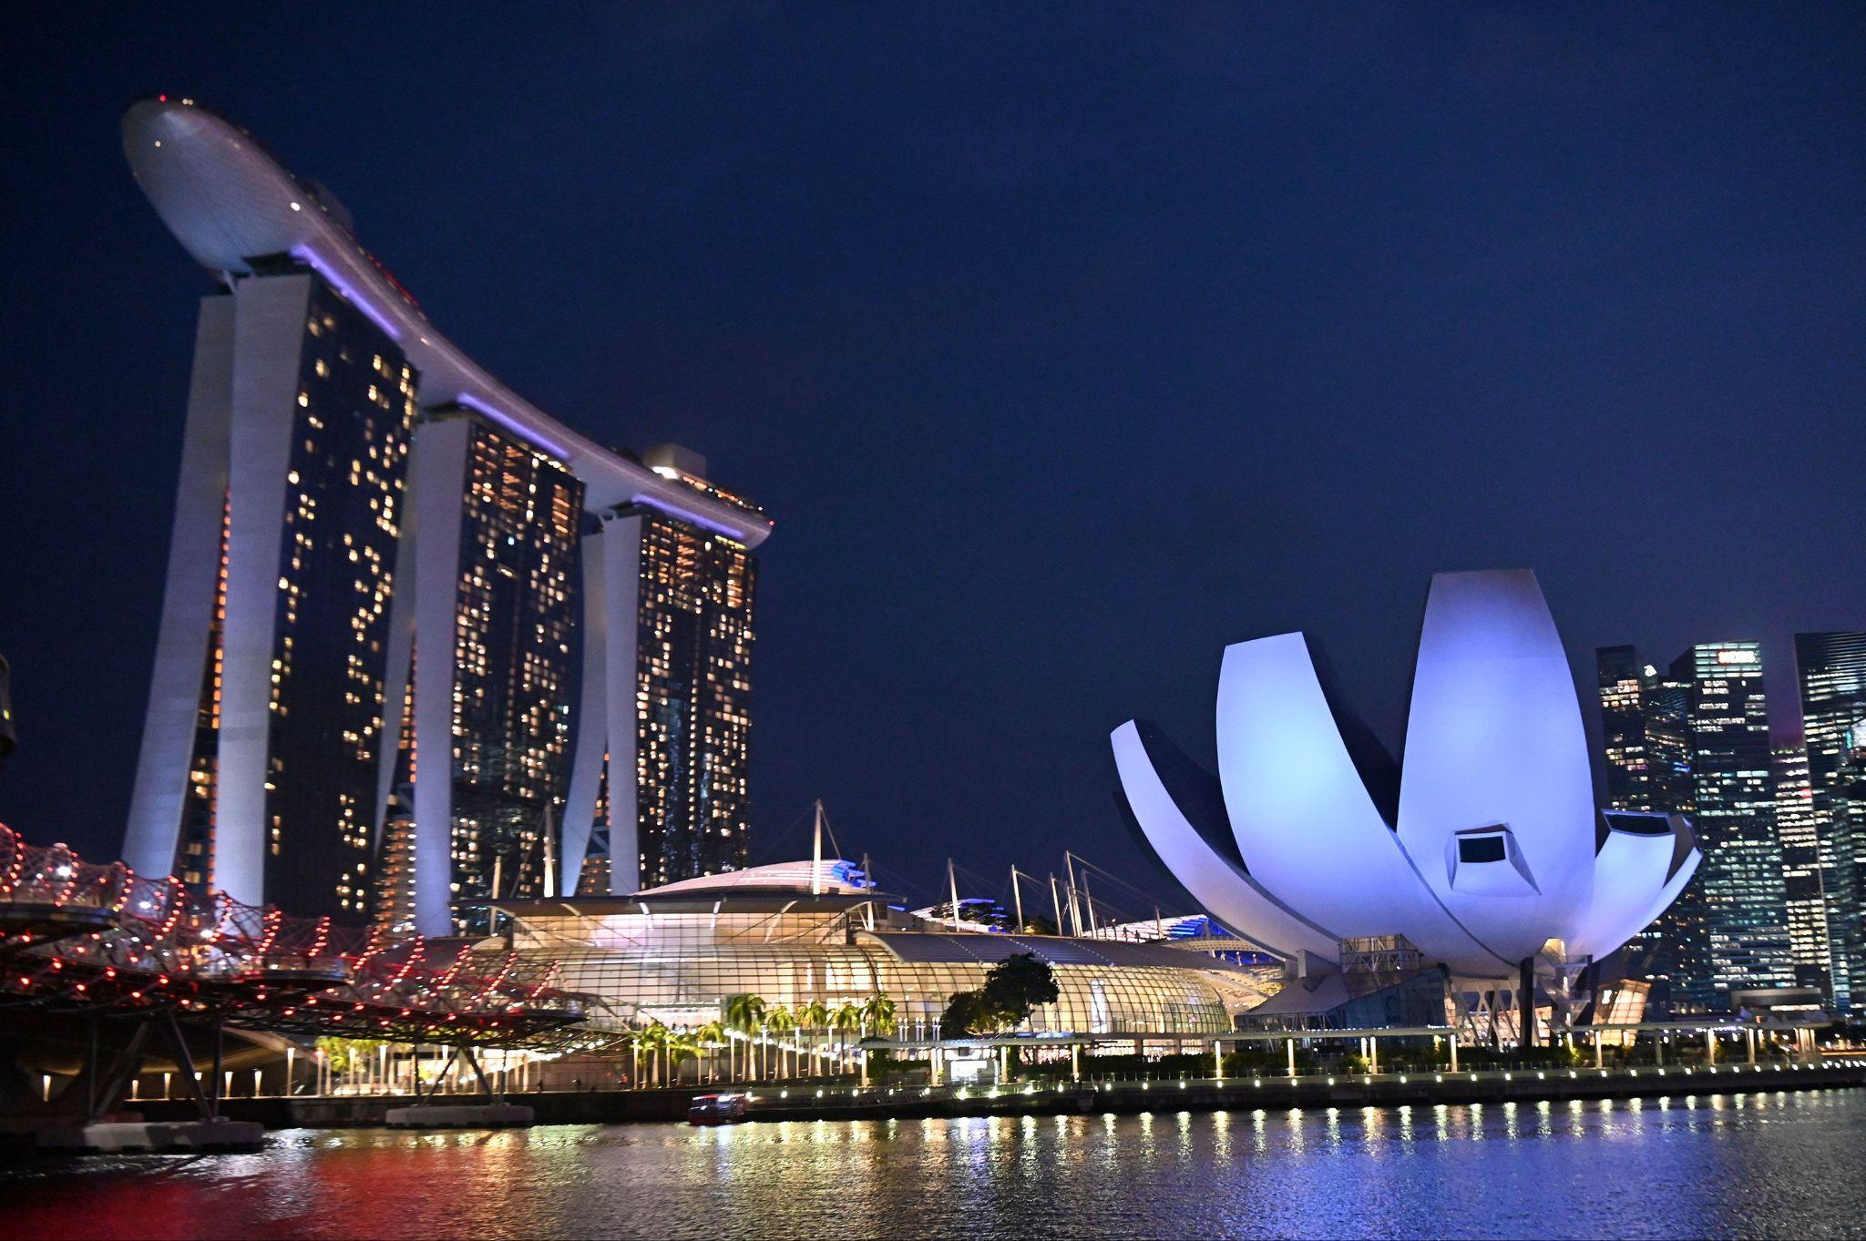
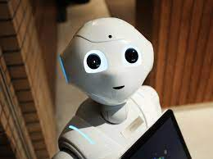
INTRODUCTION
Marriott International Facing pressure to innovate ai strategy for hotel brands
Front-facing ai solutions such as:
Digital concierges
Service robots
Automatic check in/out systems
Should marriott deploy guest-facing ai in singapore?
Which ai solutions to be implemented?

Slide 3
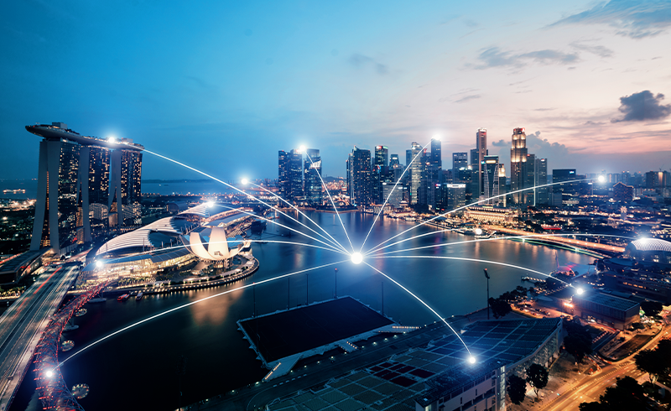
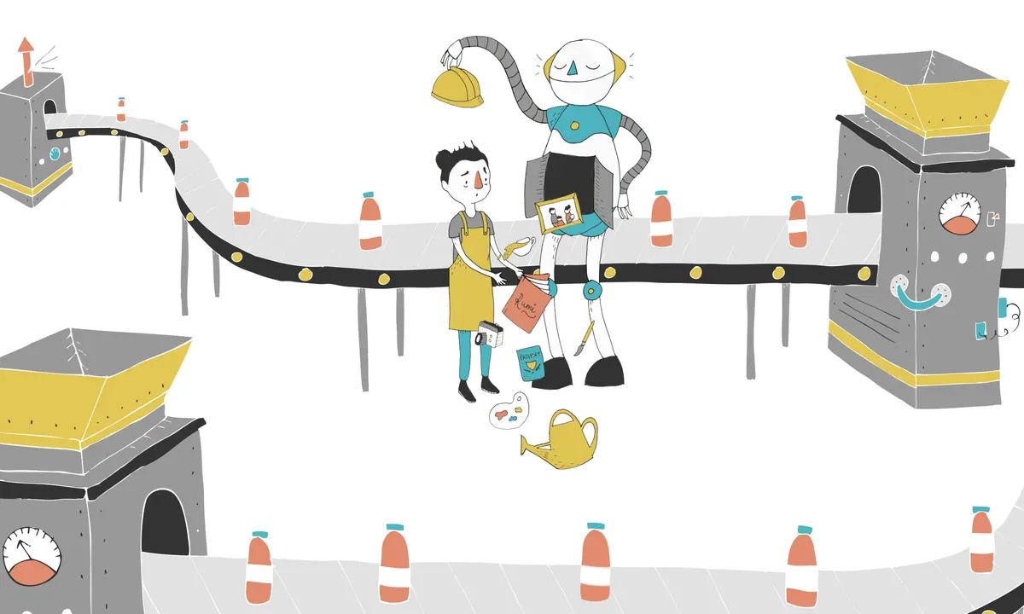
SINGAPORE & AI
Singapore familiar with technological innovation
reputation as a core center of technology and finance
automation in transportation, healthcare, or general tech services
- general weariness amongst working population
- Shows that our AI System for Marriott would most likely be welcomed considering AI familiarity
- Affects the jobs of the concierges/Other hotel workers, who might lose their jobs to automation

Slide 4
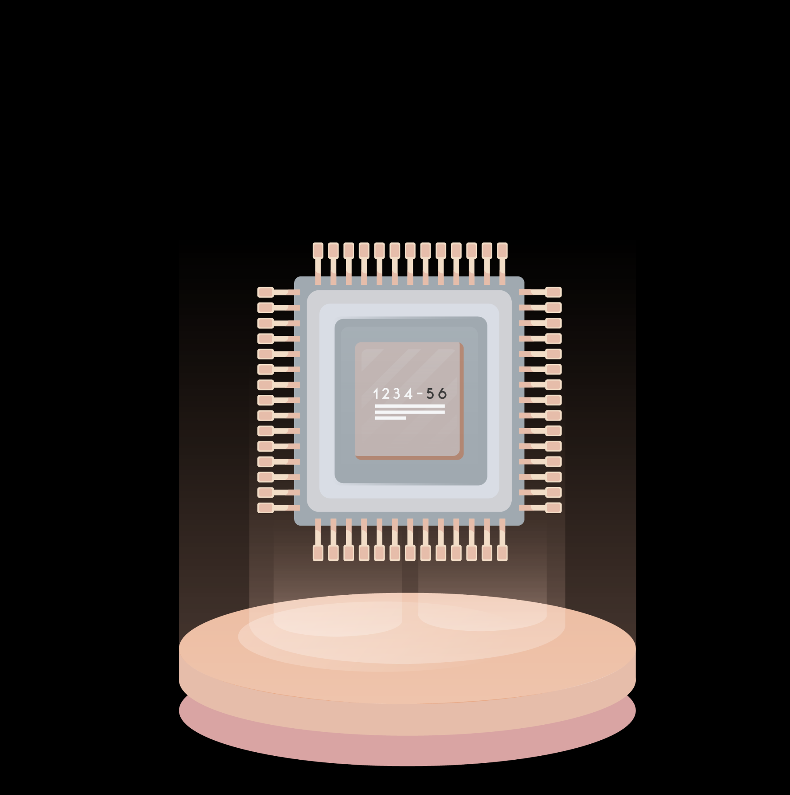
Tourism & Singapore

Slide 5

City-State
One of only three city-states
Other being monaco and vatican
Population is only about 5.4M
Known for being a financial center

Slide 6
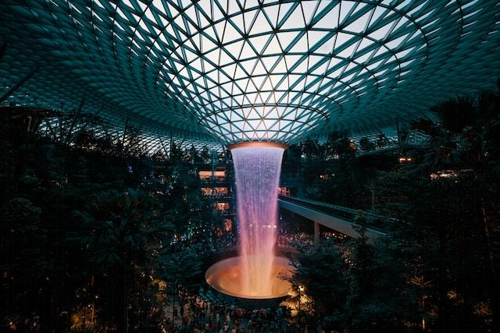
Tourism Sector
Expecting to hit 12-14 million visitors by the end of 2023.
Preferred step-over cities for many travellers connecting between europe and asia
Changi Airport is continuously voted as best airport in the world.
Known as “instant asia” because of its diversity and its inhabitants from all over asia.
Languages spoken include : English, Malay, Tamil, Mandarin
Serves as HQ for more than 500 fortune 500 companies
fourth in terms of the number of ultra-rich residents

Slide 7
Types of AI
Analytical AI
used to predict busy and low seasons for the hotels, using the data to maximize revenue
Chatbots
Hotels use AI-powered chatbots to handle customer inquiries, provide information, and help with bookings, often through social media or their own websites
Personalization
AI algorithms analyze guest preferences and data to provide personalized recommendations for room selection, dining options, and local attractions
Facial recognition
Some hotels use AI-powered facial recognition systems for check-in, check-out, and security purposes
Housekeeping and maintenance
AI can predict when rooms will need cleaning or when equipment requires maintenance, improving efficiency and reducing costs

Slide 8
Downsides to AI
People sometimes get frustrated with technology because it can’t handle certain niche requests
IE if someone has a weird issue with their account
It feels less personal to interact with a machine than another human being
For things such as facial recognition, it requires you to trust the hotel with biometric data which can make people uncomfortable and also puts more liability on the hotel
Initial financial investment can be high in the hospitality / hotel industry
Even if you outsource it, the amount of requests it needs to handle, tech that needs to be installed, and data it needs to be trained on all add up the costs
Possibility for it to be fed / trained on bad data, making it perform worse (where as if a human makes a mistake, it is easy to correct it an AI will take much longer to learn a correction)

Slide 9
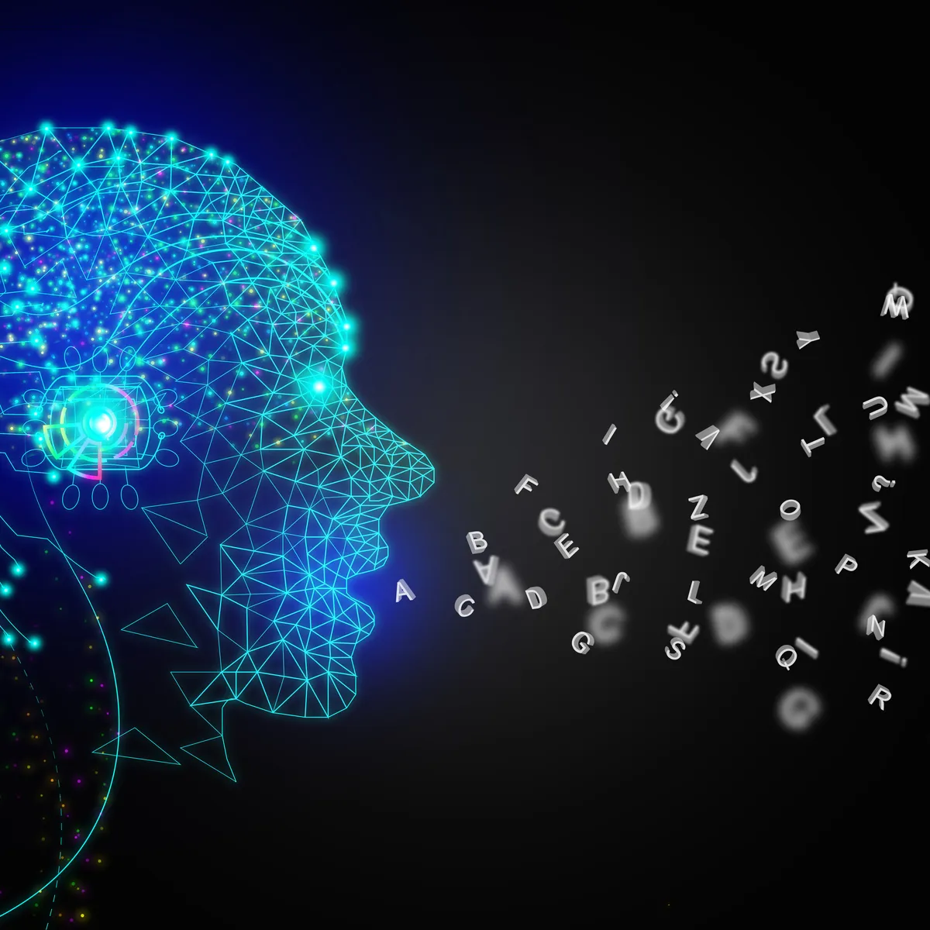
Digital Concierges
A Digital Concierge is an a.i. Chatbot designed to interact with potential clients
The advantages of a digital concierge include
Being able to answer common questions
Can chat like a human in multiple languages (has personality)
Can track events
Can be used for target advertising
24/7 support
Much faster response time compared to human agents
“In fact, 86% of hoteliers agreed that AI improved employee satisfaction according to a 2019 report from Starfleet Research and Oracle Hospitality”

Slide 10
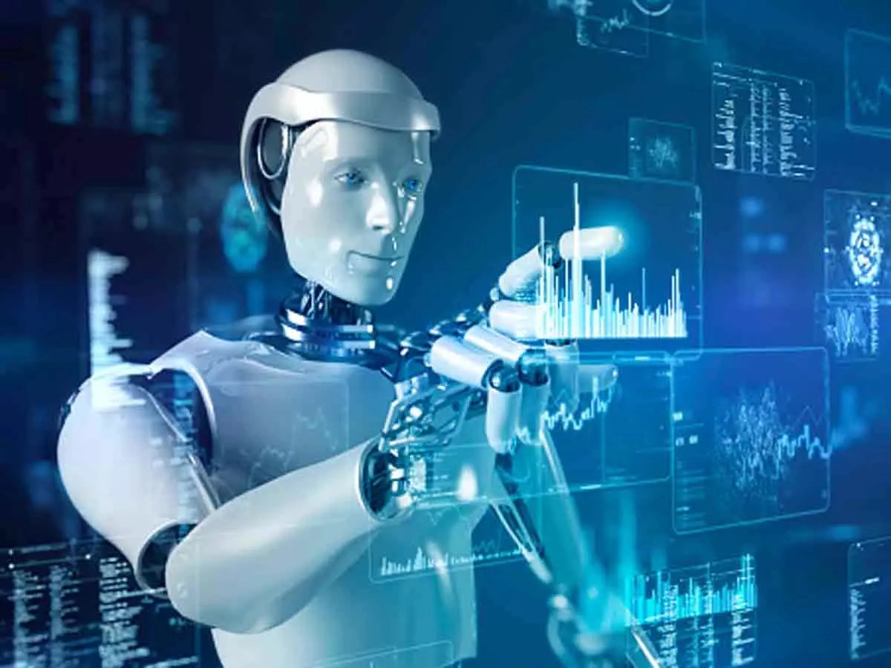
Service Robots
Service Robots come in all different shapes and sizes
Robot hotel in Japan
“The hotel opened in July 2015 and maintains 80 robots, including an arm robot that carries luggage, porter robots, a female robot and a dinosaur robot at the reception desk, desktop robots for indoor customer service, and robotic cleaners. According to Guinness World Records, it is the first ever robot hotel.”
Can have luggage handlers, desk workers, cleaners
Automated air conditioning
Can be operated on any schedule food little cost
Not as good as human cleaners
Less on-site staff needed
Future holds many possibilities(automated taxi)
“we conducted a field survey and analysis of the Henn-na Hotel, which is mostly operated by robots instead of employee”

Slide 11


Automatic Check-in/out Systems
Can have automated check-in/out that would remove any needed interaction for check-in
Can have timed facial recognition locks
Potential for biometric scanner
Will further reduce human-staff requirements
Can have an alexa equivalent to request hotel services
- Room service
- Cleaning request
- Thermostat requests

Slide 12
Thank YOu - ANY questions?

Slide 13
SOURCES
https://www.cio.com/article/221994/how-singapore-is-using-artificial-intelligence.html
https://www.revfine.com/artificial-intelligence-hospitality-industry/
https://www.google.com/imghp?hl=en&ogbl
https://www.atlys.com/en-IN/post/singapore-tourism-statistics
https://cfi.co/asia-pacific/2023/01/singapore-the-leading-financial-centre-in-the-asia-pacific-region/
https://journals.ekb.eg/article_241079_a3dcf6bb0f50d1ecc0e5ce7d5885239a.pdf
https://vtechworks.lib.vt.edu/handle/10919/105172
https://ieeexplore.ieee.org/abstract/document/8172305?casa_token=P66LnmRiGdAAAAAA:jUBlsKsKHFJgH-ZnwaApW9EMRlVka-x_--45JxXklxpnlIsG5_gug5sP9z0_ojw2Ued1MbEymk4

